Slide 1


Java Course Project
quiz management system
TEAM NO:19

Slide 2
Abstract
Quiz Management System is an online application, from which user can easily manage Academic details, Performance details, Quiz details. Admin can track all the information of Academic, Score, Performance etc. Admin can edit, add, delete and update the records of Quiz, Participate, Winner.

Slide 3
Limitations
Unregistered users can only access the home page not anything else.
1
Student only can Check their result by the help of Admin
2
This system is only for IT field students not for other students.
3

Slide 4
Advantages
Reduces Administrative Burden.
Reduces Exam Conducting Costs
Immediately Possible To Furnish Analysed Results
Minimizes Chances of Cheating
Saves Environment.
Highly Secured.

Slide 5

Design Template of Project
HOME PAGE

Slide 6
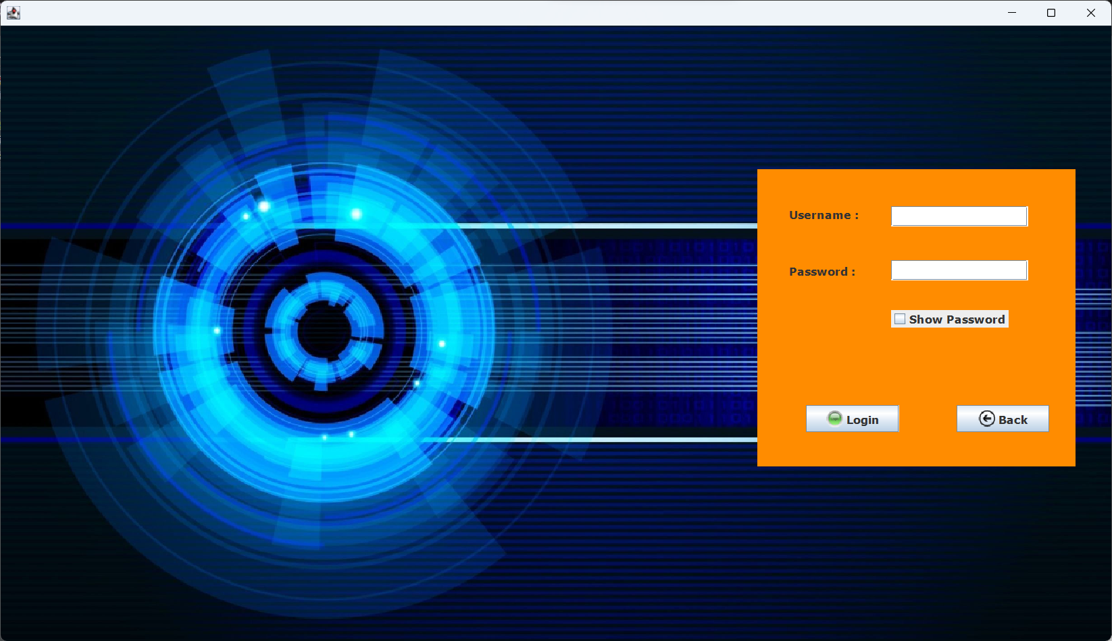
Design Template of Project
ADMIN LOGIN

Slide 7

Design Template of Project
ADMIN PAGE

Slide 8
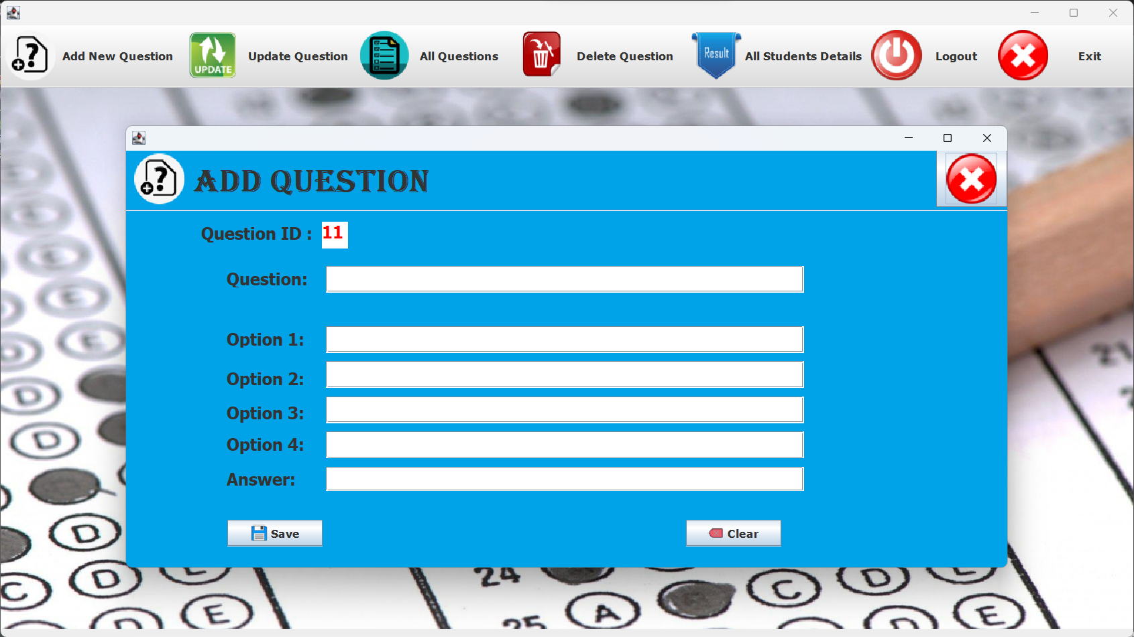

Slide 9
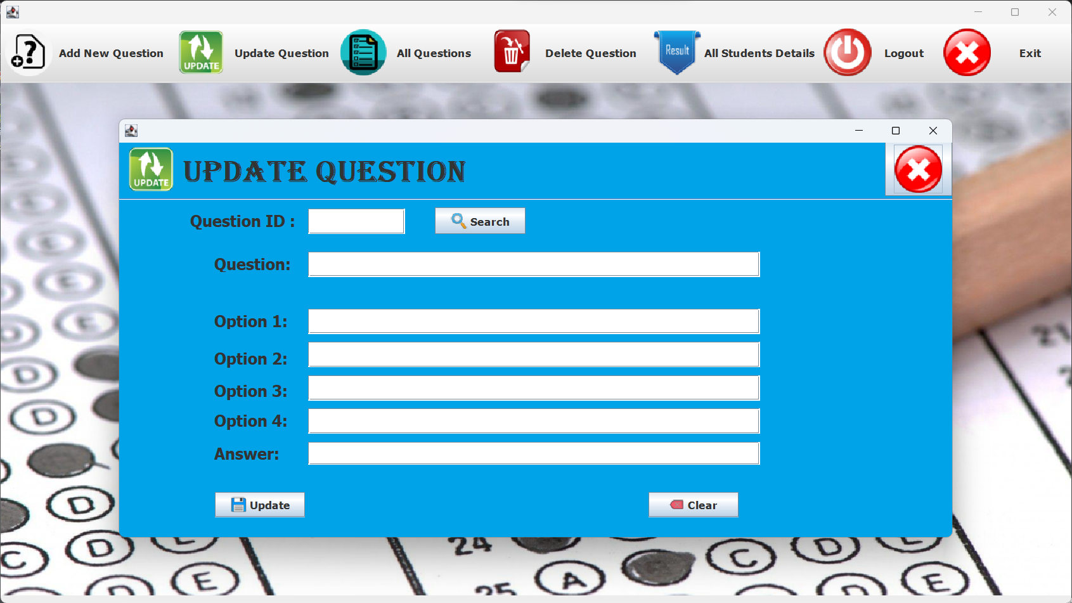

Slide 10
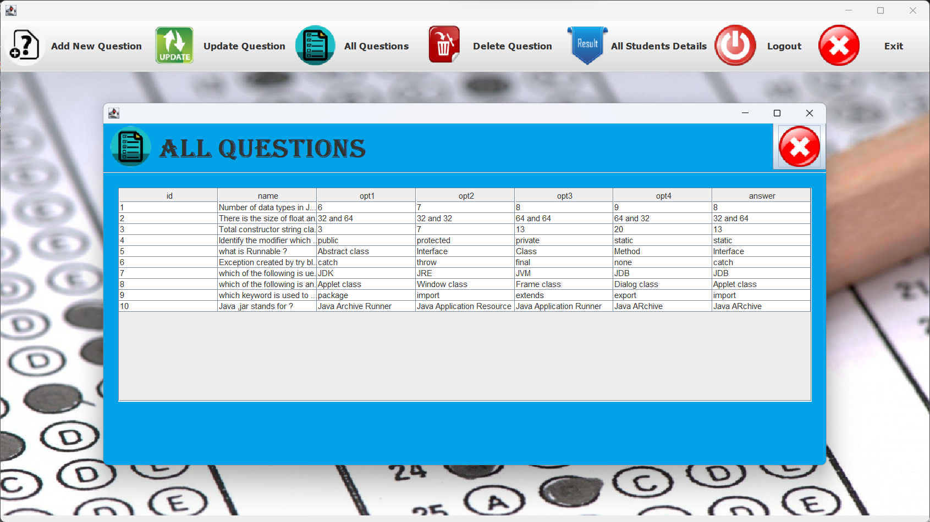

Slide 11


Slide 12
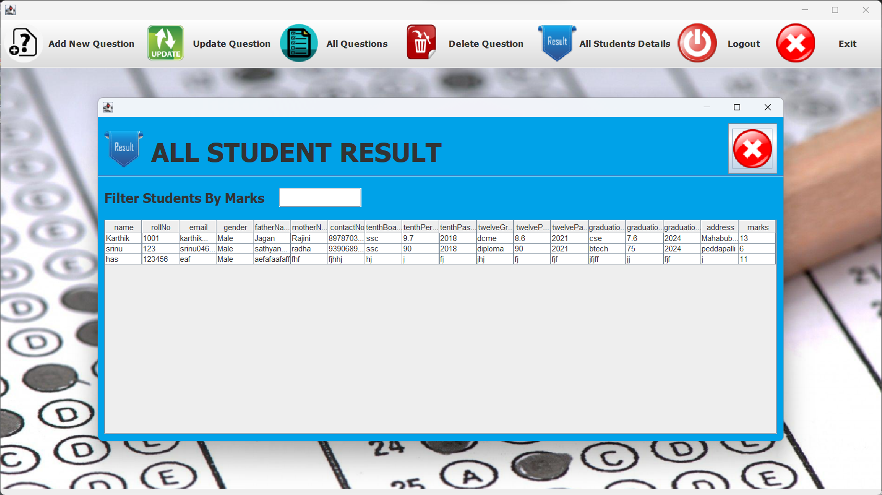

Slide 13
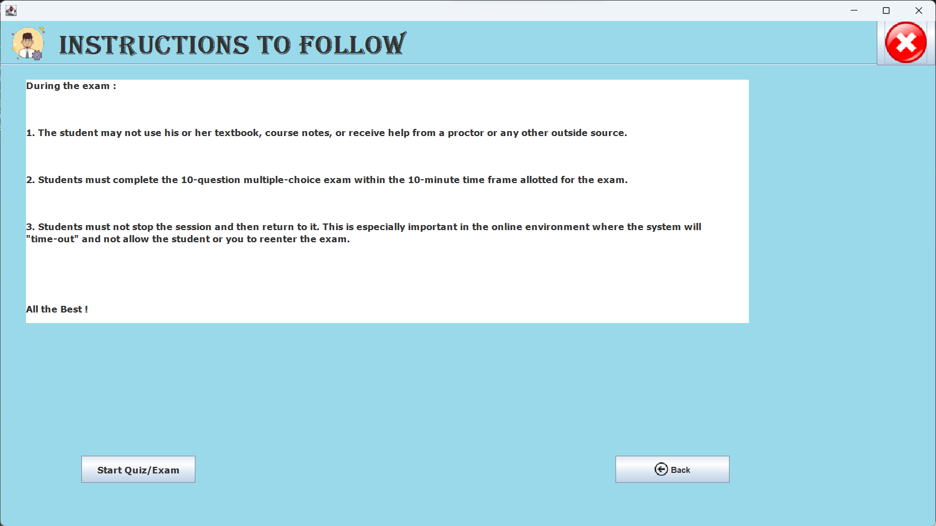

Slide 14
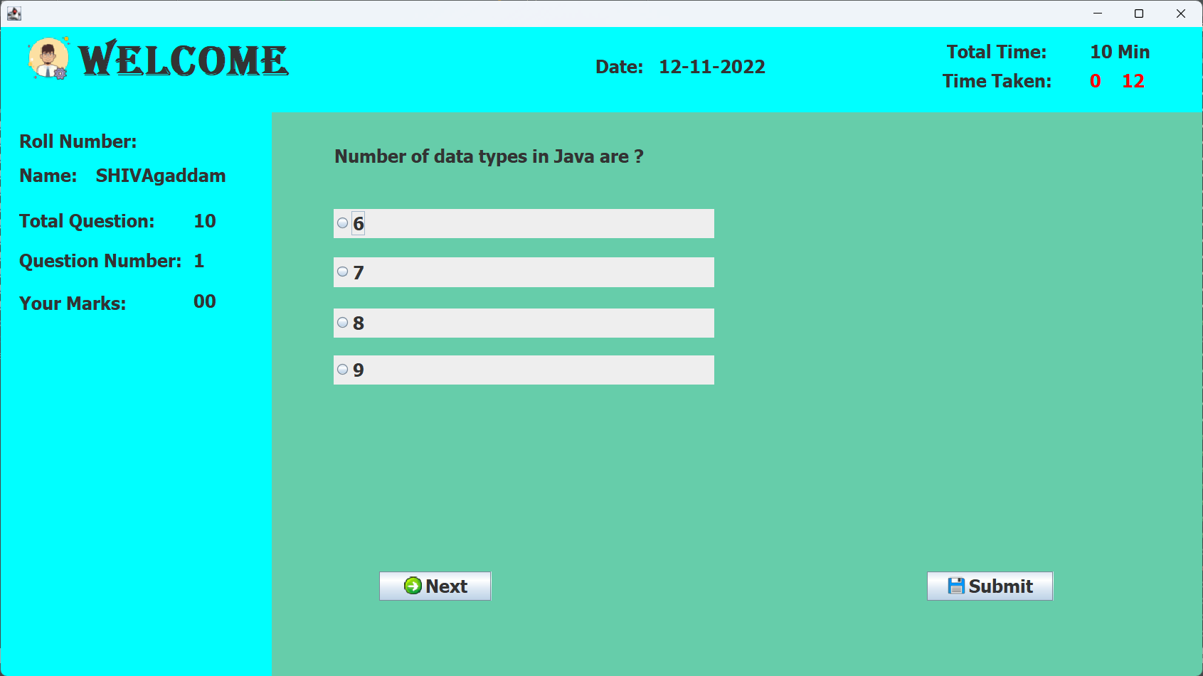
Design Template of Project
STUDENT PAGE

Slide 15
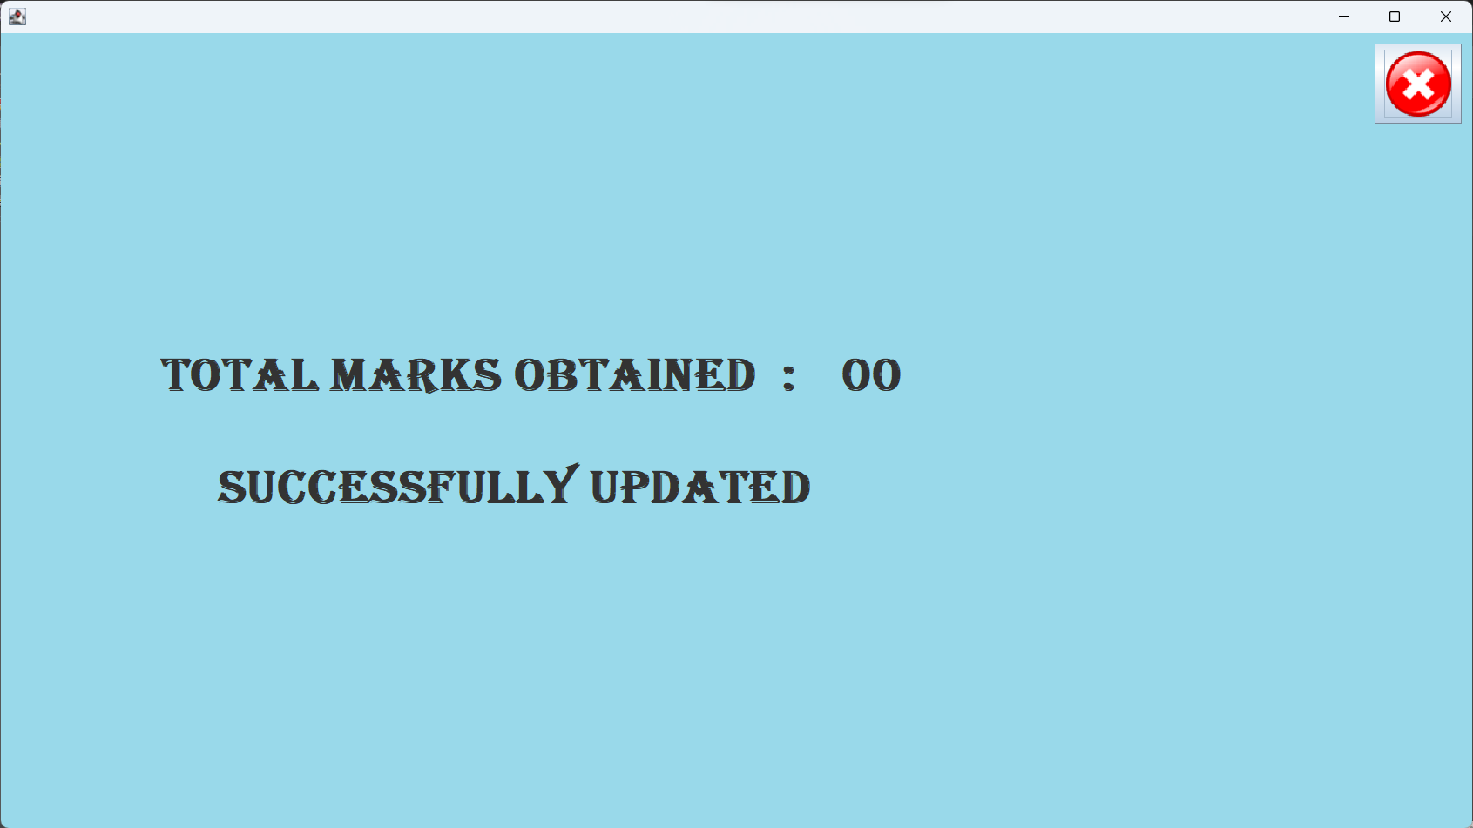

Slide 16
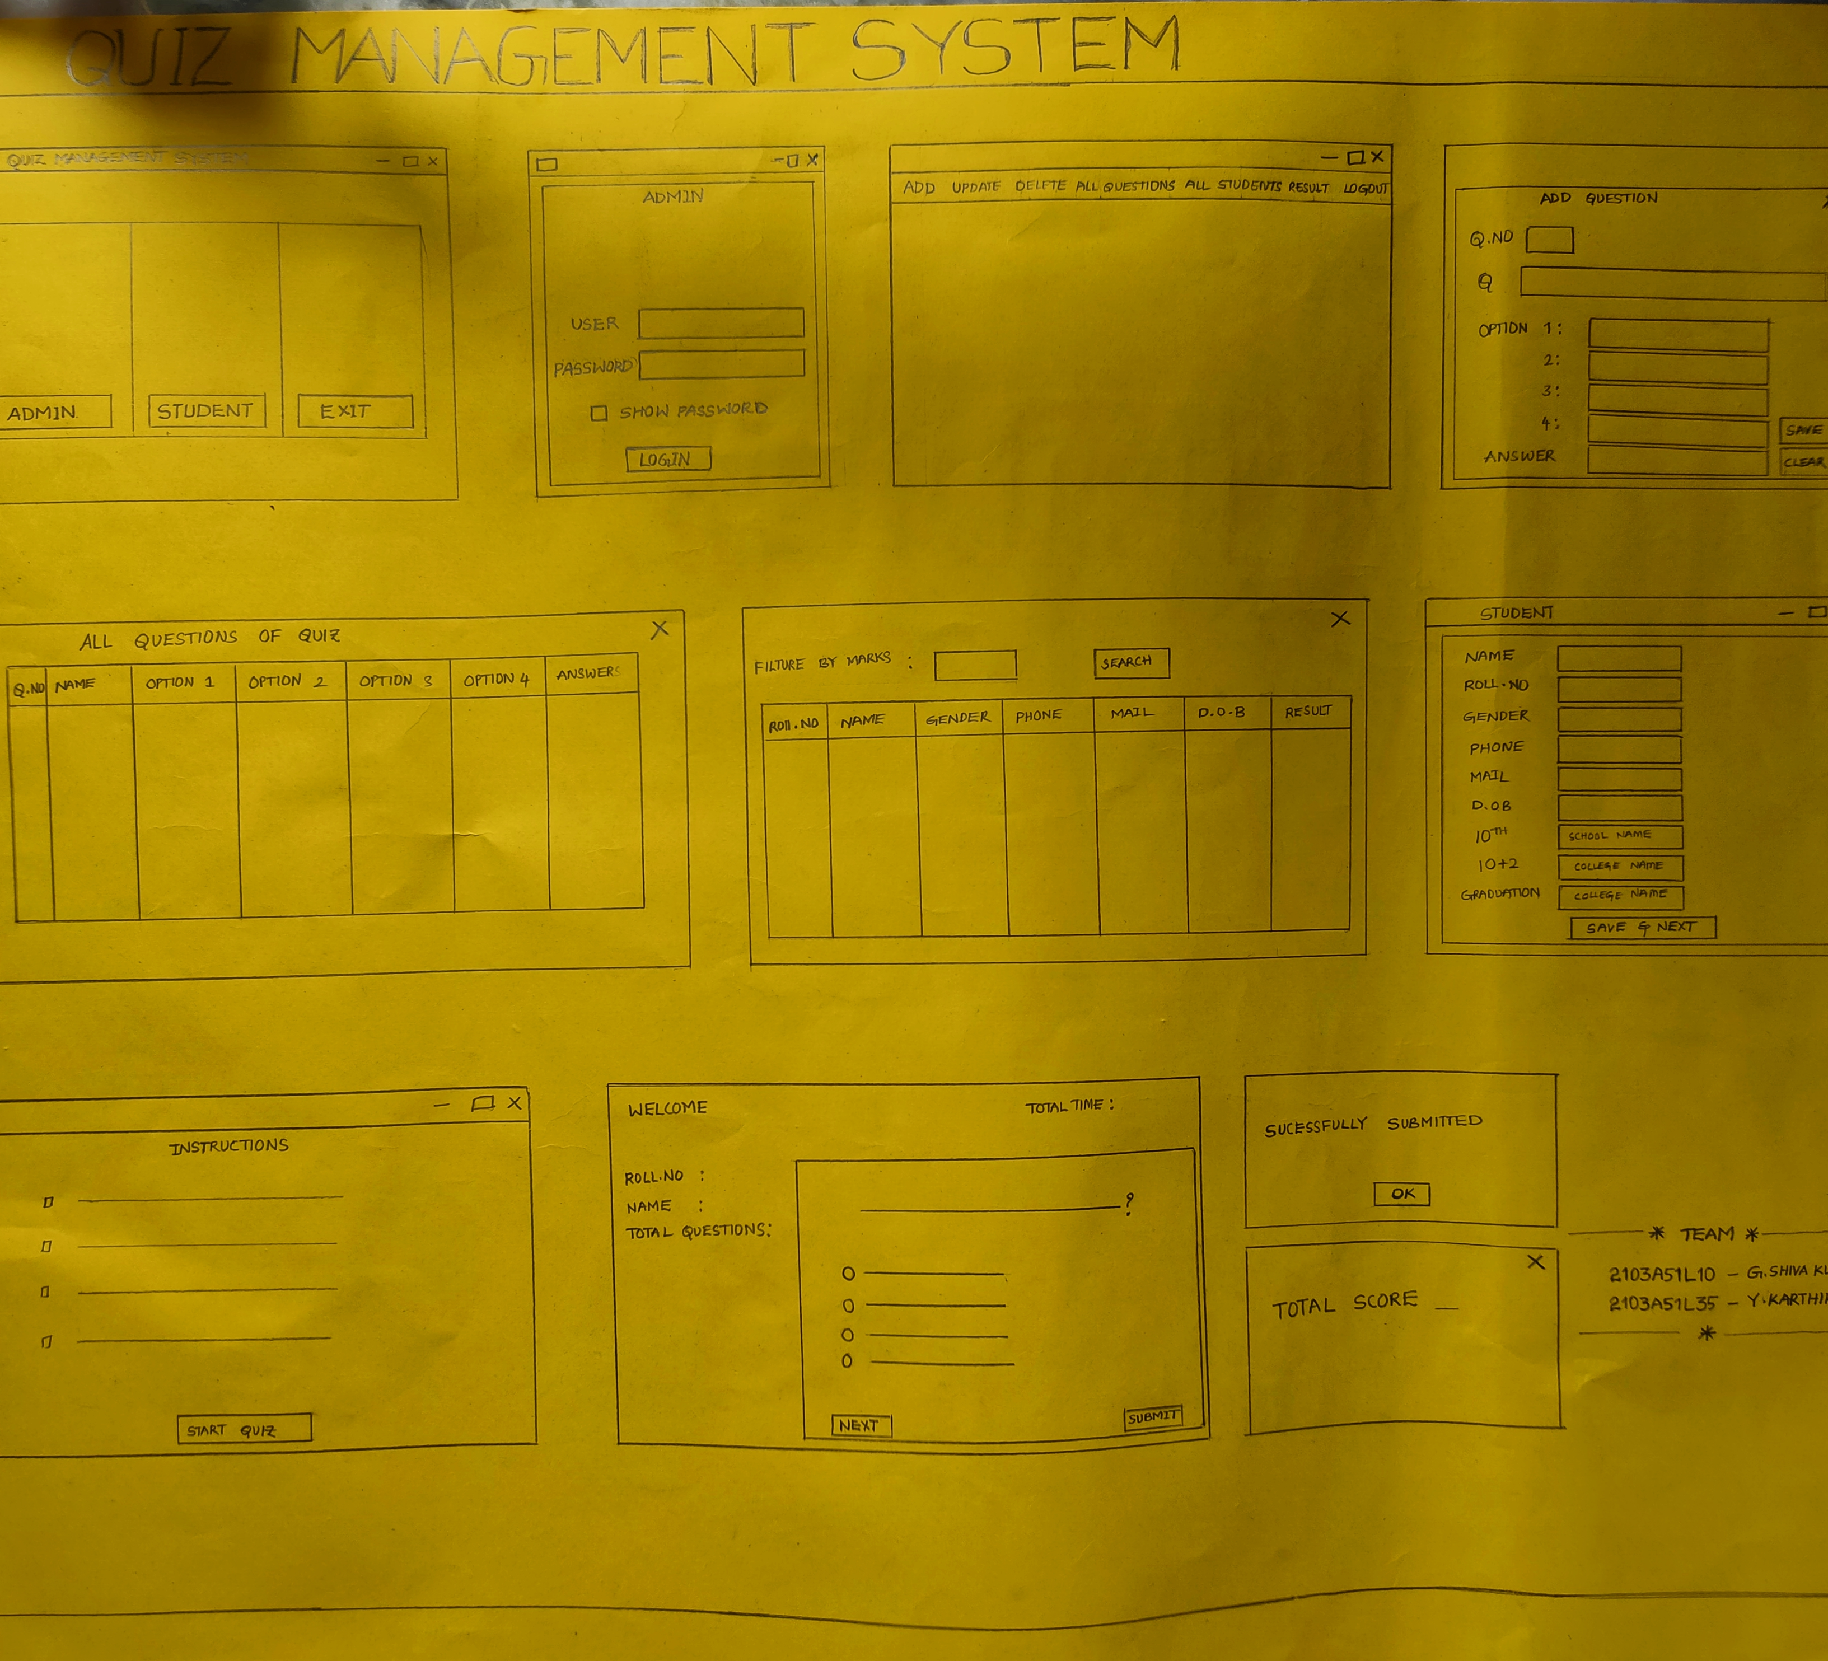
Design Template of Project
CHART DIAGRAM

Slide 17

THANK YOU
G.SHIVA KUMAR
2103A51L10
Y.KARTHIK
2103A51L35

